Slide 1
Course: Cloud, Microservices and Applications
UNIT II: Virtualization
SESSION 10
Taxonomy of virtualization techniques
Date: 4/8/2021

Slide 2
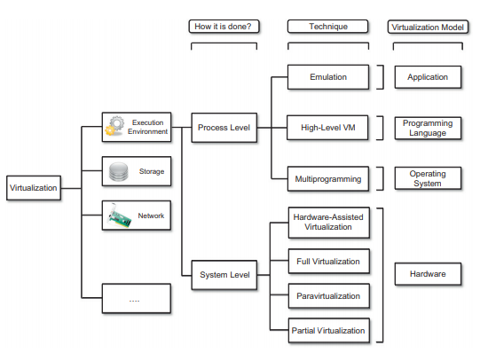

Slide 3
Hardware virtualization techniques
Hardware-assisted virtualization.
This term refers to a scenario in which the hardware provides architectural support for building a virtual machine manager able to run a guest operating system in complete isolation.
Products such as VMware Virtual Platform, introduced in 1999 by VMware,
After 2006, Intel and AMD introduced processor extensions, and a wide range of virtualization solutions took advantage of them: Kernel-based Virtual Machine (KVM), VirtualBox, Xen, VMware, Hyper-V, Sun xVM, Parallels, and others

Slide 4
Hardware virtualization techniques
Full virtualization
Full virtualization refers to the ability to run a program, most likely an operating system, directly on top of a virtual machine and without any modification, as though it were run on the raw hardware
The principal advantage of full virtualization is complete isolation, which leads to enhanced security, ease of emulation of different architectures, and coexistence of different systems on the same platform
A key challenge is the interception of privileged instructions such as I/O instructions

Slide 5
Hardware virtualization techniques
Paravirtualization
This is a not-transparent virtualization solution that allows implementing thin virtual machine managers.
Paravirtualization techniques expose a software interface to the virtual machine that is slightly modified from the host and, as a consequence, guests need to be modified.
The aim of paravirtualization is to provide the capability to demand the execution of performance-critical operations directly on the host, thus preventing performance losses that would otherwise be experienced in managed execution

Slide 6
Hardware virtualization techniques
Partial virtualization
Partial virtualization provides a partial emulation of the underlying hardware, thus not allowing the complete execution of the guest operating system in complete isolation.
Partial virtualization allows many applications to run transparently, but not all the features of the operating system can be supported, as happens with full virtualization.
An example of partial virtualization is address space virtualization used in time-sharing systems;

Slide 7
Operating system-level virtualization
Operating system-level virtualization offers the opportunity to create different and separated execution environments for applications that are managed concurrently
This virtualization technique can be considered an evolution of the chroot mechanism in Unix systems
operating system-level virtualization aims to provide separated and multiple execution containers for running applications.

Slide 8
Operating system-level virtualization
This technique is an efficient solution for server consolidation scenarios in which multiple application servers share the same technology: operating system, application server framework, and other components.
Examples of operating system-level virtualizations are FreeBSD Jails, IBM Logical Partition (LPAR), SolarisZones and Containers, Parallels Virtuozzo Containers, OpenVZ, iCore Virtual Accounts, Free Virtual Private Server (FreeVPS), and others

Slide 9
Programming language-level virtualization
Programming language-level virtualization is mostly used to achieve ease of deployment of applications, managed execution, and portability across different platforms and operating systems.
It consists of a virtual machine executing the byte code of a program, which is the result of the compilation process.
The main advantage of programming-level virtual machines, also called process virtual machines, is the ability to provide a uniform execution environment across different platforms

Slide 10
Programming language-level virtualization
From a development lifecycle point of view, this simplifies the development and deployment efforts since it is not necessary to provide different versions of the same code
Security is another advantage of managed programming languages; by filtering the I/O operations, the process virtual machine can easily support sandboxing of applications

Slide 11
Application-level virtualization
Application-level virtualization is a technique allowing applications to be run in runtime environments that do not natively support all the features required by such applications.
In general, these techniques are mostly concerned with partial file systems, libraries, and operating system component emulation
Emulation can also be used to execute program binaries compiled for different hardware architectures

Slide 12
Application-level virtualization
In this case, one of the following strategies can be implemented:
Interpretation- every source instruction is interpreted by an emulator
Binary translation- every source instruction is converted to native instructions with equivalent functions
Application virtualization is a good solution in the case of missing libraries in the host operating system
Another advantage is that in this case the virtual machine manager is much lighter

Slide 13
Application-level virtualization
Compared to programming-level virtualization, which works across all the applications developed for that virtual machine, application-level virtualization works for a specific environment
One of the most popular solutions implementing application virtualization is Wine, which is a software application allowing Unix-like operating systems to execute programs written for the Microsoft Windows platform

Slide 14
Any Questions???

Slide 15
Thank You

